Slide 1
Gender Pay Gap Report
Snapshot – Friday 5 April 2024

Slide 2




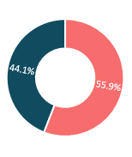
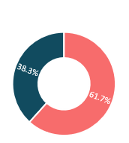
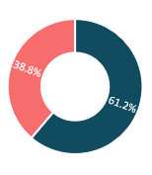
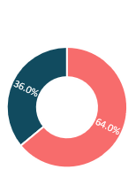
Our 2024 Gender Pay Gap Report
Davies All UK: Snapshot - Friday 5 April 2024
A gender pay gap is a measure of the difference in the average pay of men and women across the entire organisation, regardless of the work they do. It highlights the different number of men and women across all roles. It is different from an equal pay comparison, which involves a direct comparison of two people or groups of people carrying out the same work or work of equal value. For the purposes of the reporting requirements, we refer to men and women. We recognise that gender is not a binary concept, and we support transgender, non-binary and intersex colleagues alongside those who identify as male or female. You will find more information about our gender reporting in our Responsible Business Report.
  The data we are reporting includes:
  the difference in the mean (average) and median (middle) pay of men and women,
  the difference in mean and median bonus pay of men and women,
  the proportions of men and women who were paid a bonus in the previous year, and
  the numbers of men and women employed in quartile pay bands.
  A positive % indicates a favourable pay gap towards men, and a negative % indicates a favourable pay gap towards women.
Quartile Pay Bands
(percentage of women/men in each hourly pay quarter)
Red: Women Blue: Men
Bonus Pay Gap
Bonus pay includes any additional pay relating to profit sharing, productivity or performance, when in the form of money or vouchers
In our case, most of bonus pay is in the form of commission, the Davies Incentive Plan and annual bonus payments. The methodology stated in the gender pay gap regulations requires us to report on the difference in the actual amount of bonus received by our colleagues.
Lower
Quartile Bottom 25% of earners
Gender Pay Gap | Davies All UK (Davies UK & Keoghs, a Davies Business, Combined) | External Benchmark: Activities auxiliary to financial services and insurance
Median | 23.7% | 29.5%
Mean | 23.8% | 37.0%
Lower Mid
Quartile
What is the difference between the median and the mean figures?
Median pay gap: If all our colleagues were lined up in a female line and a male line, in order of pay from highest to lowest, the median gender pay gap compares the pay of the female in the middle of their line and the pay of the man in the middle of their line regardless of the work they do.
Mean pay gap: The other measure is the mean gender pay gap, which shows the difference in average hourly rate of pay between men and women. This is also affected by the different numbers of men and women in different roles.
Upper Mid
Quartile
Receiving Bonus
45.5%
54.7%
MEN
WOMEN
Upper
Quartile Top 25% of earners
Bonus Pay Gap
Median | 19.6%
Mean | 59.0%

Slide 3
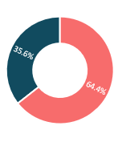
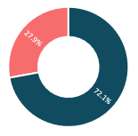
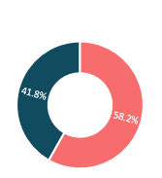
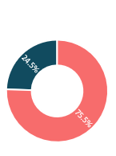
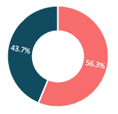
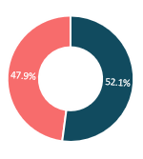
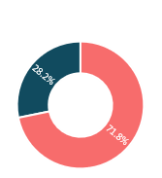
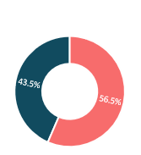
Pay and bonus gap split by legal entity
Davies UK
Quartile Pay Bands
Red: Women
Blue: Men
Keoghs a Davies Business
Quartile Pay Bands
Red: Women
Blue: Men
 | Pay Gap |  | Bonus Pay Gap
 | Davies UK 2024 | Keoghs 2024 | Davies UK 2024 | Keoghs 2024
Median | 25.8% | 19.6% | 22.8% | 16.0%
Mean | 27.9% | 13.8% | 69.5% | 6.8%
Lower
Quartile Bottom 25% of earners
Lower
Quartile Bottom 25% of earners
Employee Resource Groups (ERGs)
We value the differences and benefits that a diverse workforce brings, we are committed to creating and maintaining an environment that embraces diversity and inclusion and where everyone is treated equitably. Supporting those guiding principles requires the contribution of everyone and we have launched specific groups which each have senior business sponsors and members and allies from across the group.
Our ERGs:
Women’s Network: Supports women at Davies to build their networks, share advice and develop leadership skills.
My Culture & Heritage: Celebrates the wide variety of backgrounds, cultures & beliefs of all our people.
LGBTQ+: Acts as a network for members of the LGBTQ+ community & allies.
Working Families & Caregivers: Provides support and guidance for those caring for dependents or supporting those who care for others.
Supporting Our Health & Wellbeing: Provides a supportive environment for anyone seeking guidance with issues, whether mental, physical, or invisible that they are experiencing or helping someone through.
Eco Davies:
Creates a platform for our employees to engage and promote sustainable practices.
Lower Mid
Quartile
Lower Mid
Quartile
Upper Mid
Quartile
Upper Mid
Quartile
Upper
Quartile
Top 25% of earners
Upper
Quartile
Top 25% of earners
Receiving Bonus
Receiving Bonus
42.4%
49.6%
58.1%
65.2%
MEN
WOMEN
MEN
WOMEN

Slide 4

Our Results And Commitment
Our results overall
This year we have collated our data in two ways - all Davies employees in UK and then separated the reportable legal entities Davies UK and Keoghs, a Davies business. As different jobs pay differently, and the number of men and women performing these jobs varies, a gender pay and bonus gap exists. Over recent years, a significant part of Davies growth has been via acquisition. These acquisitions reshape our organisation each time and our reportable numbers - since the last report we have grown by over 200 employees and this continues to grow with every acquisition.
When we compare our results with those of our industry, the figures suggest our gap is smaller than our sector averages. According to data published by the Office of National Statistics in 2024, the category “insurance auxiliary to financial services and insurance activities” reported the gender pay gap as 37.0% mean 29.5% median. Our key reportable pay numbers compare as follows:
  Mean Davies 23.8% (Davies UK 27.9% & Keoghs 13.8%).
  Median Davies 23.7% (Davies UK 25.8% & Keoghs 19.6%).
Our data also shows that 45.5% of men and 54.7% of women within the business are earning bonuses. Davies has an all-employee incentive plan which colleagues can sign up to after two years’ service and are given the opportunity to receive a payment whenever there is a reportable period.
Our commitment
Over the last few years, we have invested heavily diversity, equity and inclusion and reward. Davies values diversity of thought and the benefits that a diverse workforce brings to the business.
As a result of this focus, we have created DEI guiding principles and strategy which is sponsored by our Group CEO. These include a commitment to:
  Recruitment and selection training for all hiring managers which includes a focus on unconscious bias.
  External candidate shortlists to include at least two genders for senior leadership team roles.
  Inclusive recruitment programmes.
  Development of inclusive employment policies and wrap around support.
  Quarterly reporting to ESG committee and monthly reporting to HR leads to provide insight and reinforce action planning.
  Building career and pay frameworks to promote clear progression pathways for all employees.
  We are also creating or improving our reward processes and principles that will continue to promote a fair and equitable reward offering.
We continuously work on our approach and culture to ensure the support of a diverse workforce. We are confident that progressing our commitments and having a continued focus in this area will ensure that we continue to make positive changes that are sustainable for our business and the communities we operate in.
Emma Wedderburn, Group Chief HR Officer

